Slide 1
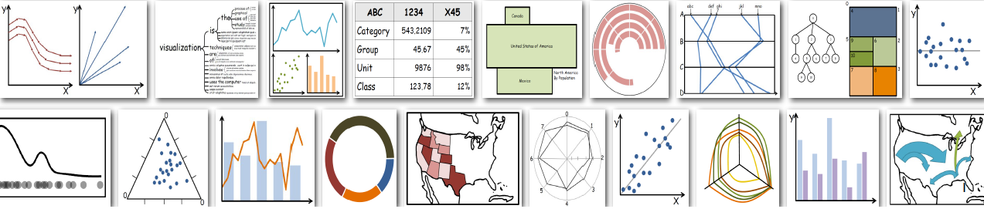
Business Analytics
Python: Plotly

Slide 2
Plotly
Plotly is a Python library for creating interactive visualizations. Unlike Matplotlib or Seaborn (which create static plots), Plotly produces interactive charts where you can zoom, hover, filter, and even export easily.
pip install plotly
https://plotly.com/python/

Slide 3
import plotly.express as px
import plotly.graph_objects as go
import seaborn as sns
import pandas as pd
# Load datasets
tips = sns.load_dataset("tips")
iris = sns.load_dataset("iris")
flights = sns.load_dataset("flights")

Slide 4
Example: Animated Graph
An airline company wants to understand passenger demand trends across different months and years (1949–1960). By analyzing this data, they can:
Identify seasonal travel peaks (e.g., summer months with high passenger traffic).
Track how airline travel grew year by year as flying became more popular.
Compare which months consistently attract higher or lower numbers of passengers.
Support resource planning, such as adding more flights during peak seasons.

Slide 5
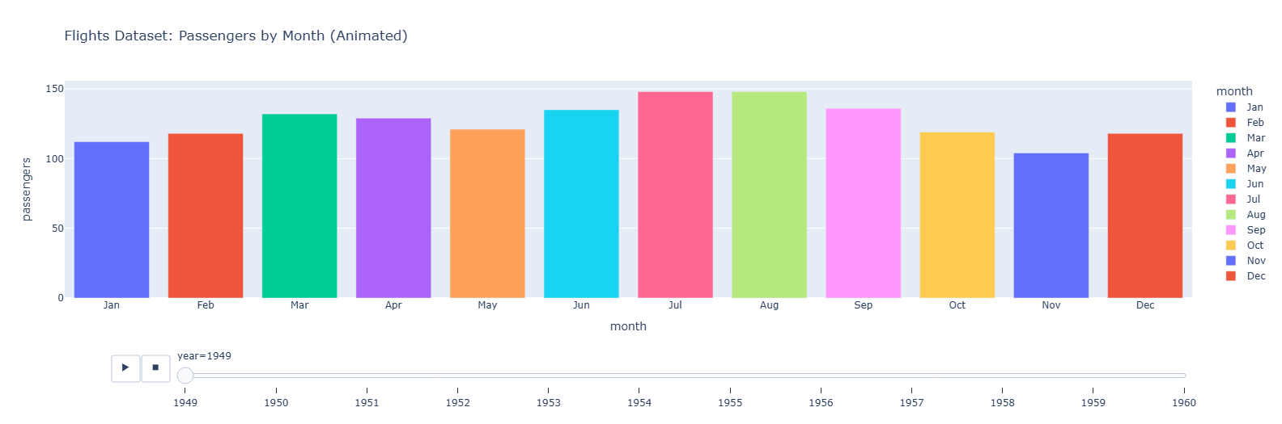
# Animated bar chart race for passengers by month over years
fig1 = px.bar(flights, x="month", y="passengers", color="month",
animation_frame="year",
title="Flights Dataset: Passengers by Month (Animated)")
fig1.show()

Slide 6
Download Animated Graph
from google.colab import files
fig1.write_html("flights_animation.html") # save inside Colab (/content/)
files.download("flights_animation.html") # download to your local machine

Slide 7
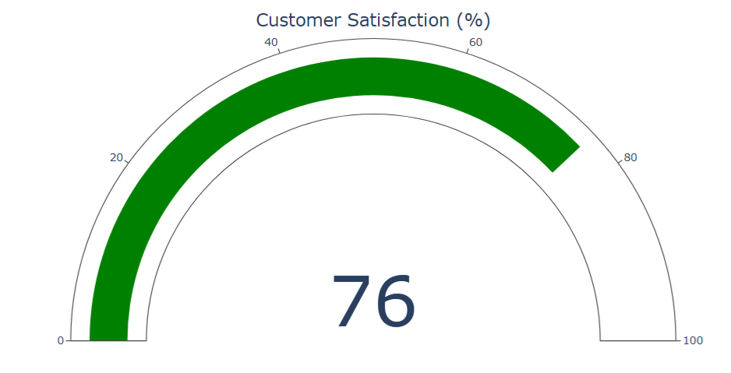
Example: KPI
import plotly.graph_objects as go
fig = go.Figure(go.Indicator(
mode="gauge+number",
value=76,
title={"text": "Customer Satisfaction (%)"},
gauge={"axis": {"range": [0, 100]}}
))
fig.show()
Indicator chart is a special chart type used for KPIs (Key Performance Indicators), gauges, numbers, and progress indicators.

Slide 8
Example: Sunburst
A restaurant manager wants to analyze customer spending patterns.
They have collected data (tips dataset) about:
Day of the week (day: Thur, Fri, Sat, Sun)
Customer gender (sex: Male, Female)
Whether the customer smokes (smoker: Yes, No)
Total spending (total_bill)
Plot Sunburst Chart using Plotly
Sunburst Chart (a hierarchical chart that looks like a circular tree map).

Slide 9
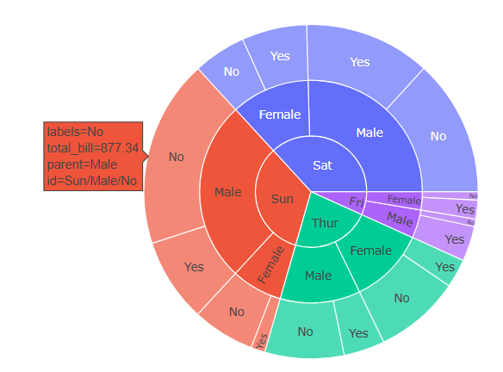
# Sunburst: Day → Gender → Smoker
fig = px.sunburst(tips, path=["day", "sex", "smoker"], values="total_bill",
title="Sunburst Chart: Spending Hierarchy")
fig.show()

Slide 10
Example: 3D Plot
import plotly.express as px
import seaborn as sns
# Load dataset
iris = sns.load_dataset("iris")
# 3D scatter plot
fig = px.scatter_3d(
iris,
x="sepal_length",
y="sepal_width",
z="petal_length",
color="species",
size="petal_width",
title="Iris Dataset: 3D Visualization of Flower Features"
)
fig.show()

Slide 11
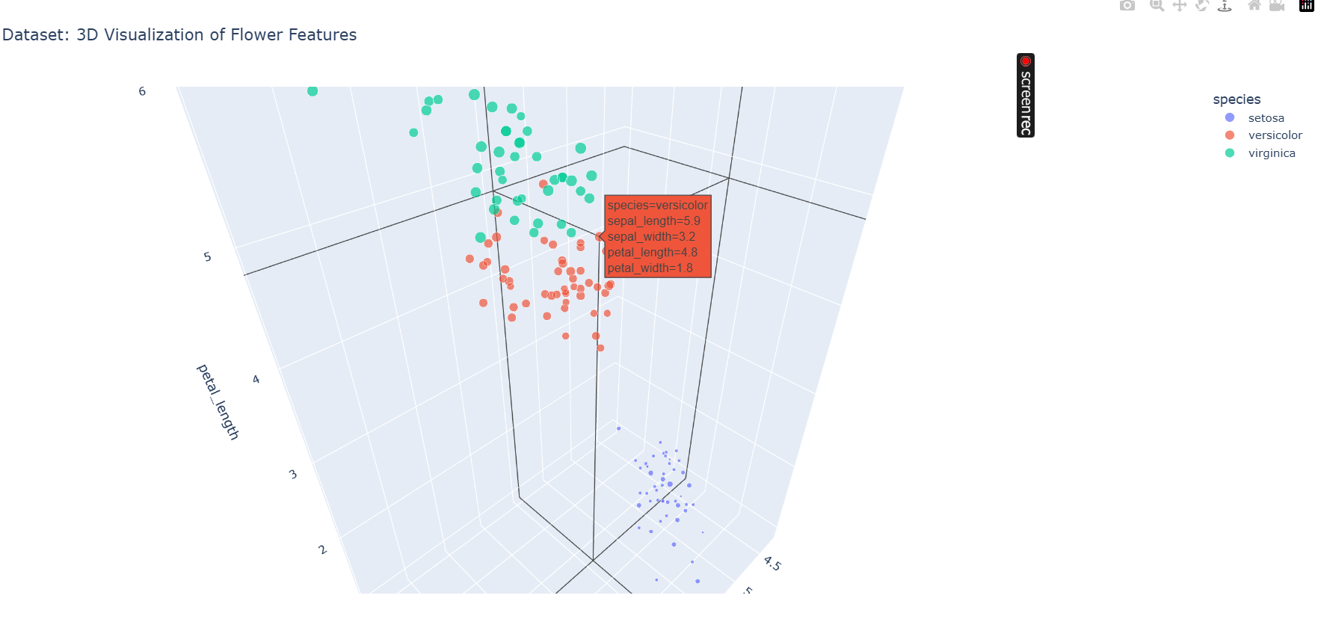

Slide 12
Example:Drop Down Menu
# Default plot (total_bill vs tip)
fig = px.scatter(tips, x="total_bill", y="tip", color="sex",
title="Tips Dataset: Compare Bills & Tips") # Dropdown options for X-axis only
axis_options = ["total_bill", "size"] # Add dropdown
fig.update_layout(
updatemenus=[
dict(
buttons=[dict(label=col,
method="update",
args=[{"x": [tips[col]]},
{"xaxis": {"title": col}}])
for col in axis_options],
direction="down",
x=0.1, y=1.15,
showactive=True
)
]
) fig.show()
updatemenus is a list that defines interactive controls (like dropdowns, buttons, sliders).

Slide 13
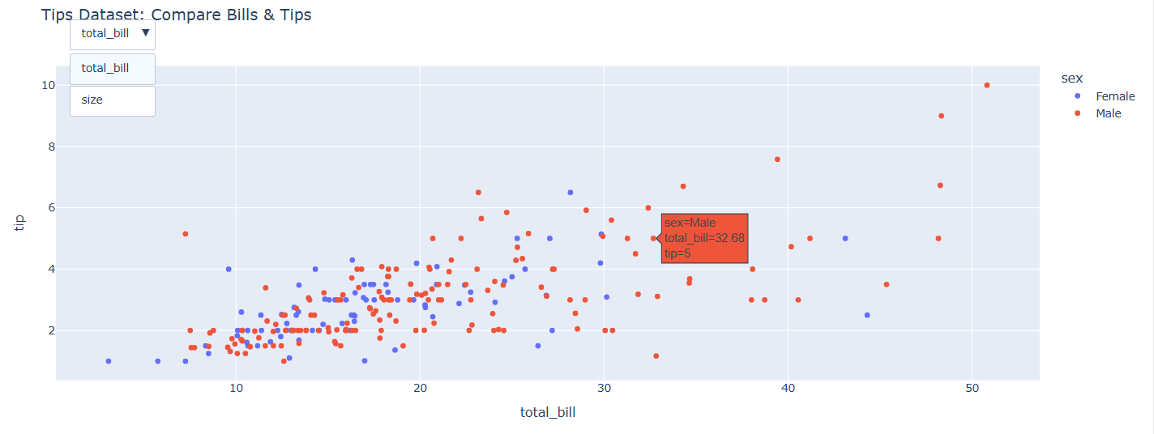

Slide 14
Example:Mini Dashboard/Sub-Plots
from plotly.subplots import make_subplots
fig = make_subplots(rows=1, cols=2, subplot_titles=("Tips", "Iris"))
fig.add_trace(px.scatter(tips, x="total_bill", y="tip").data[0], row=1, col=1)
fig.add_trace(px.scatter(iris, x="sepal_length", y="sepal_width", color="species").data[0], row=1, col=2)
fig.update_layout(title="Mini Dashboard")
fig.show()

Slide 15
